Slide 1




02 March 2026
Zimplats Website Monthly Report Analysis

Slide 2


02 March 2026
This report aims to analyze the website's performance for February 2026, focusing on traffic, user flow, traffic sources, demographics, behaviors, and security.
What Is The Purpose Of This Report?
Key metrics
Traffic overview
Audience demographics
Behavior analysis
Acquisition channels
Conversion tracking
Areas Of Focus:

Slide 3

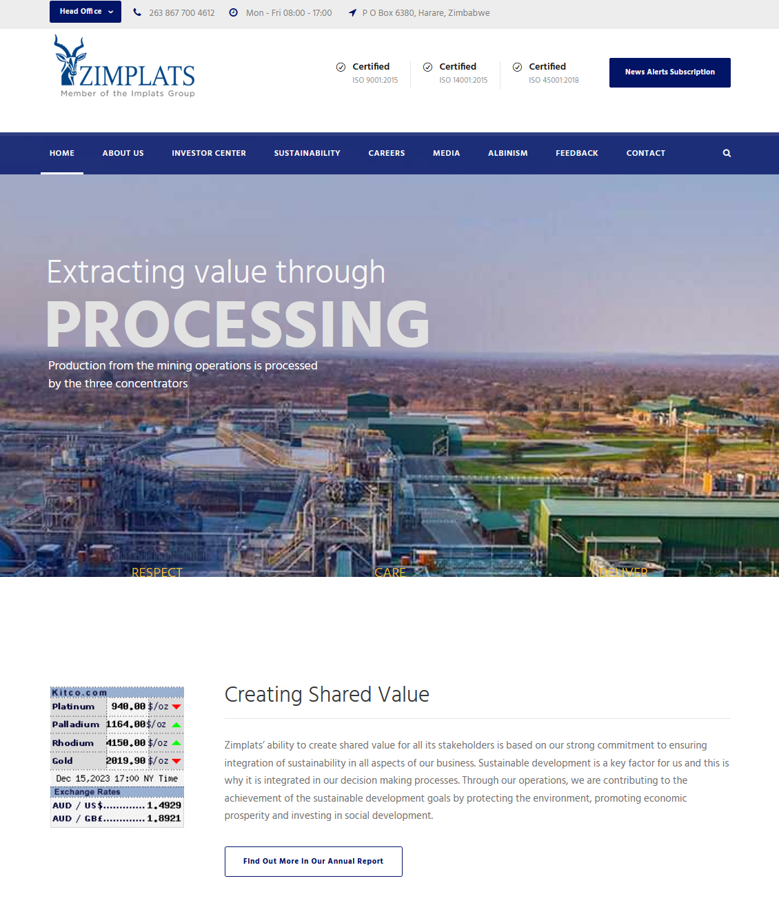

02 March 2026
Summary
Performance of the website based on data insights
In the past month, the Zimplats website attracted a total of 193 active users, with 193 being new users, these are people who have visited the website multiple times. The majority of users accessed the site through direct (112 users), while smaller numbers came via organic search (88 users). China contributed the highest traffic, with 82 users. On average, users engaged with the site for 24s seconds per session.

Slide 4
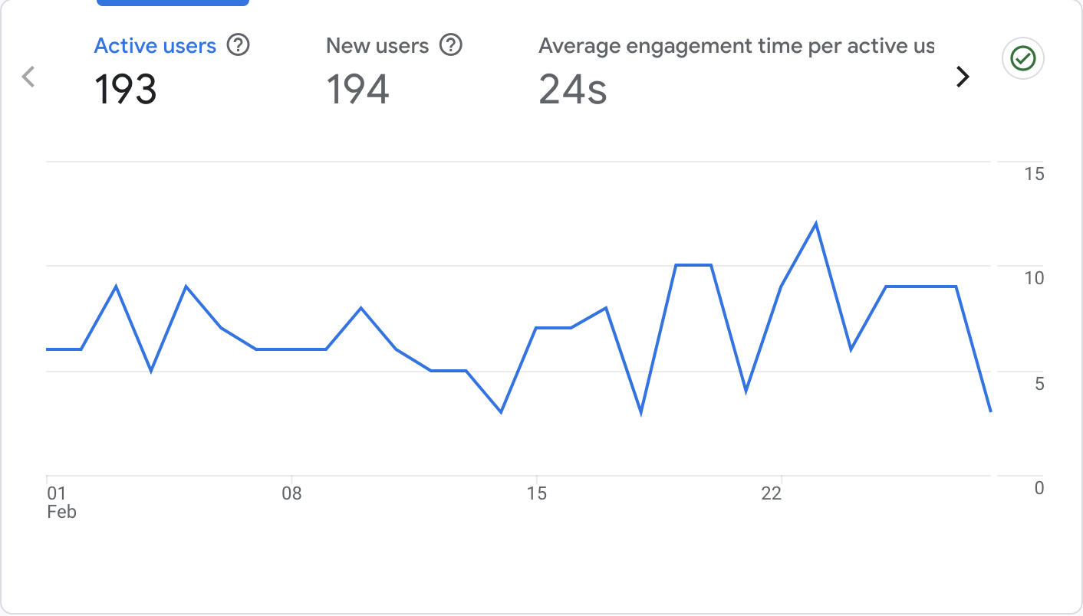
02 March 2026
Site Overview
Emphasizing the important numerical data, the large line chart on the right displays the key metrics for the Zimplats website from the previous month.
It shows:
Users : 193 active users visited the site.
New Users : 194 new users, indicating all visitors were first-time visitors.
Average Engagement Time : Users spent an average of 24s seconds on the site.

Slide 5
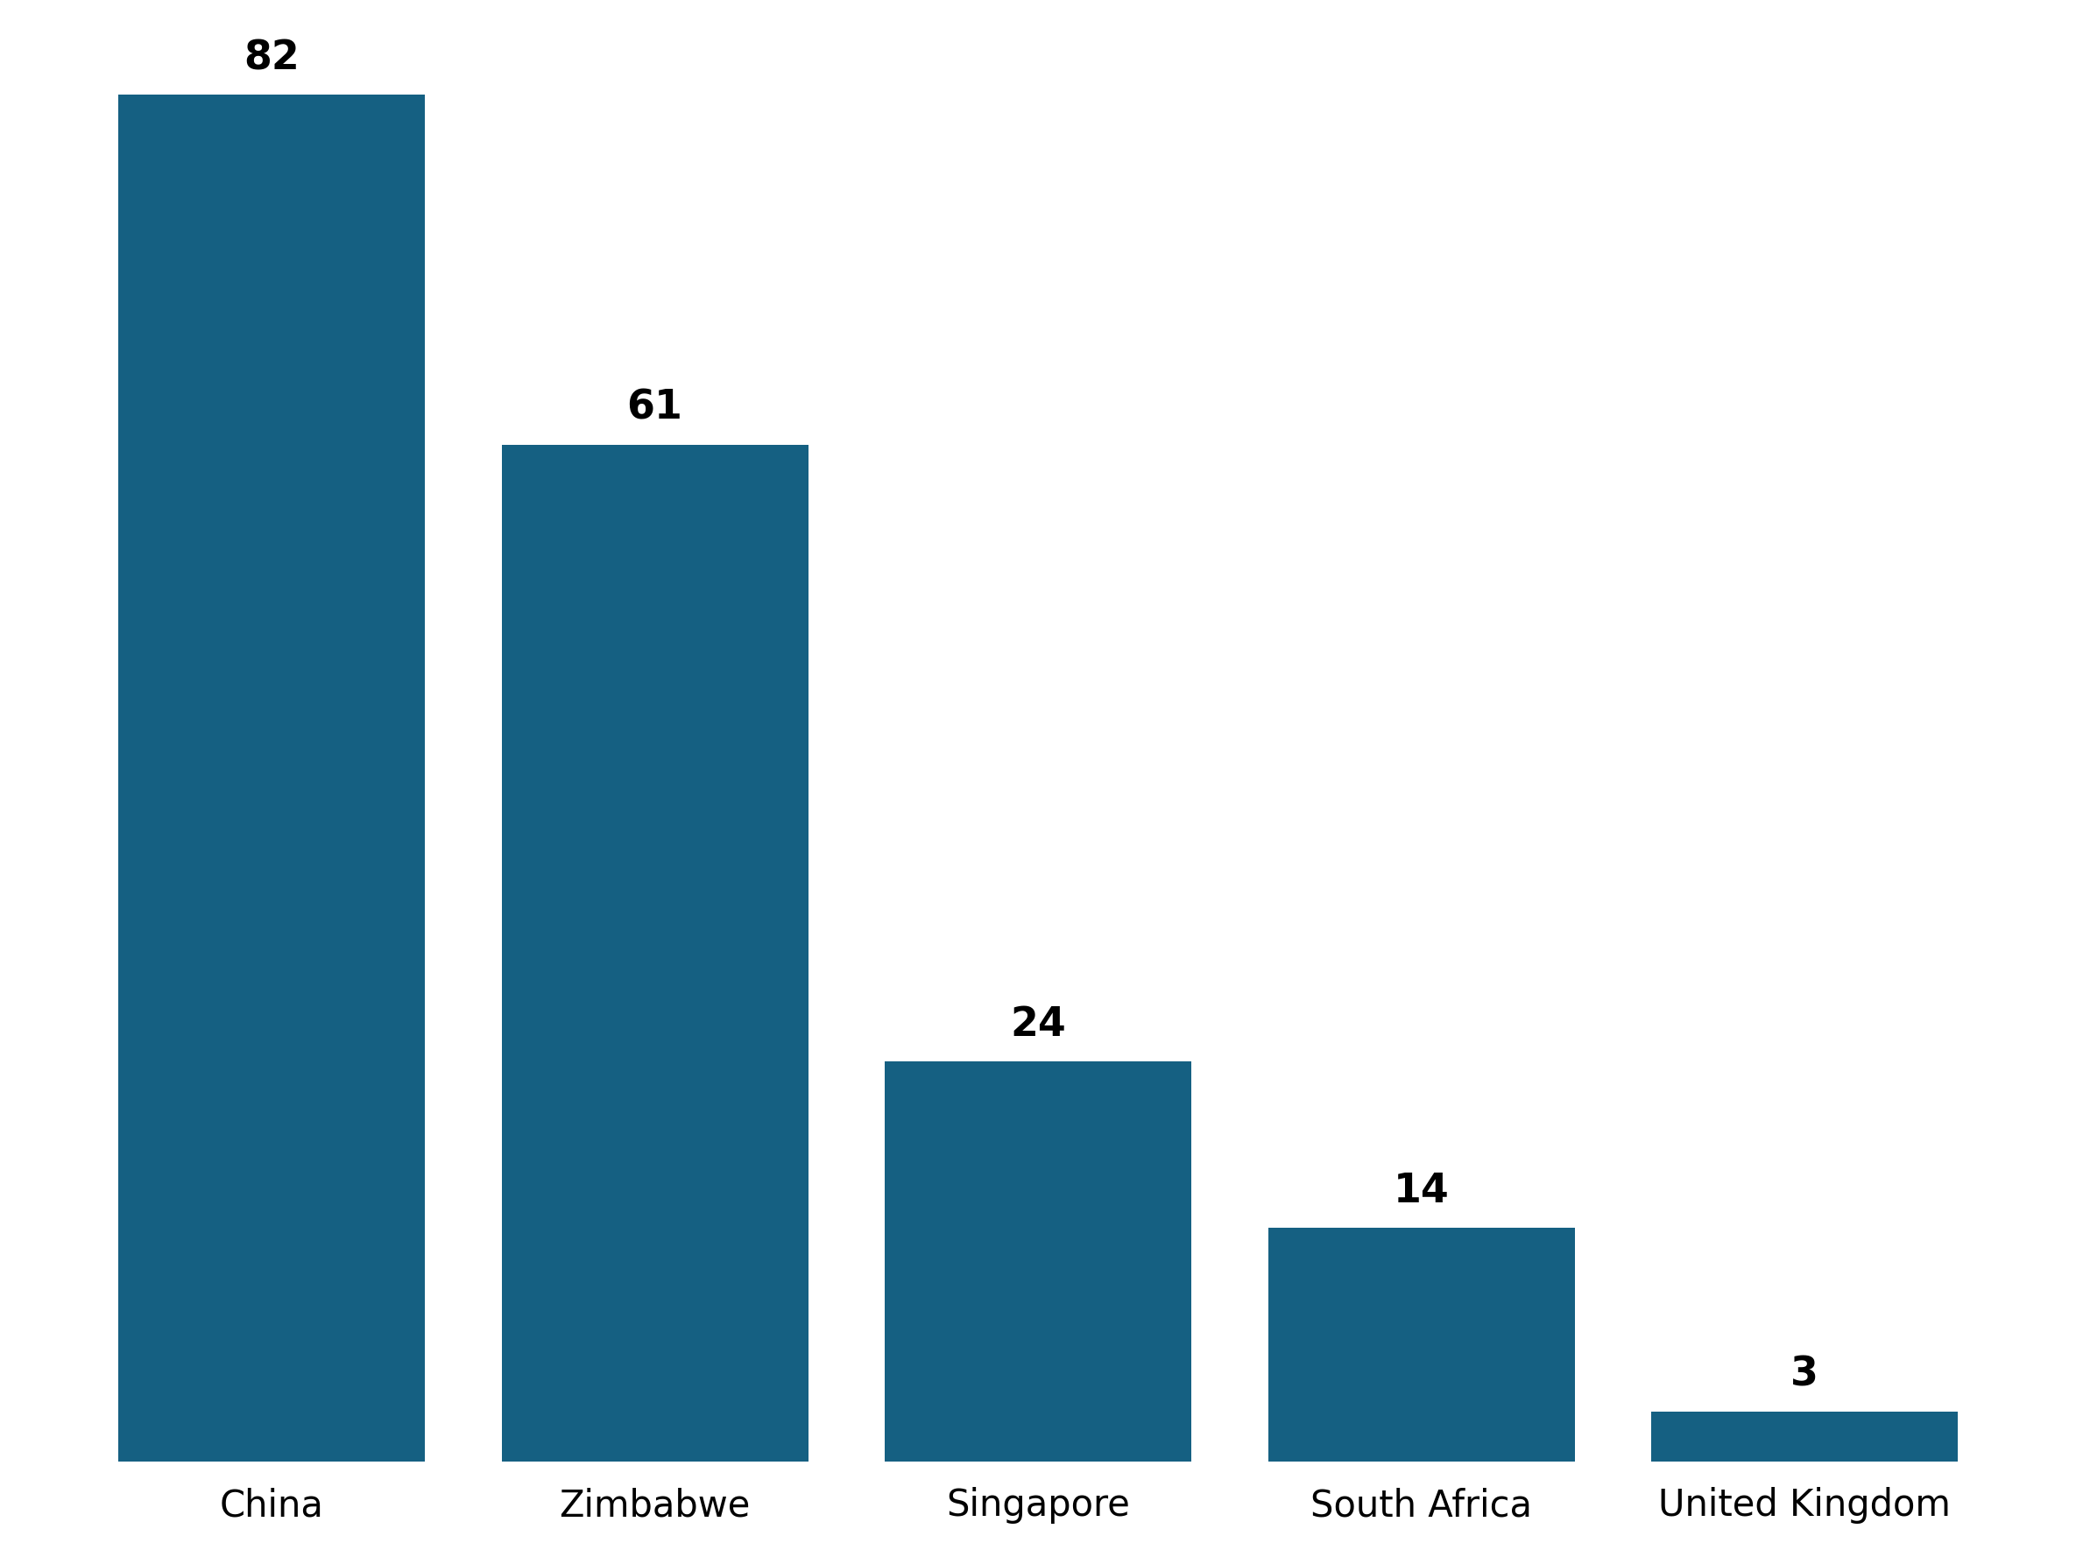
02 March 2026
Demographic Overview
Most of the traffic is coming from China (82 users) , followed by Zimbabwe with (61 users) then Singapore with (24 users) and South Africa with (14 users) each.

Slide 6
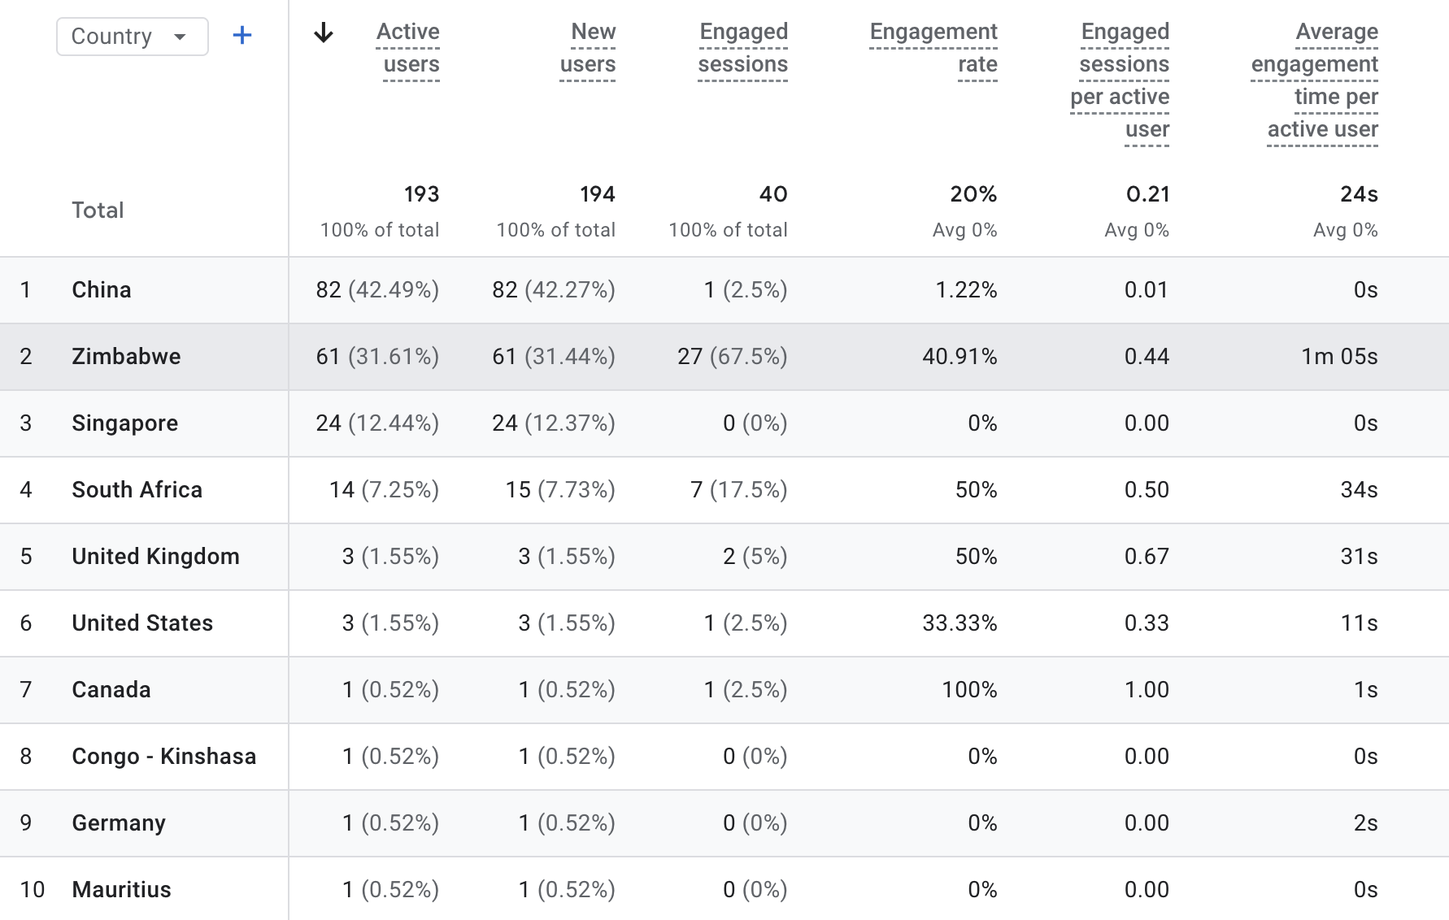
02 March 2026
Demographic Overview

Slide 7
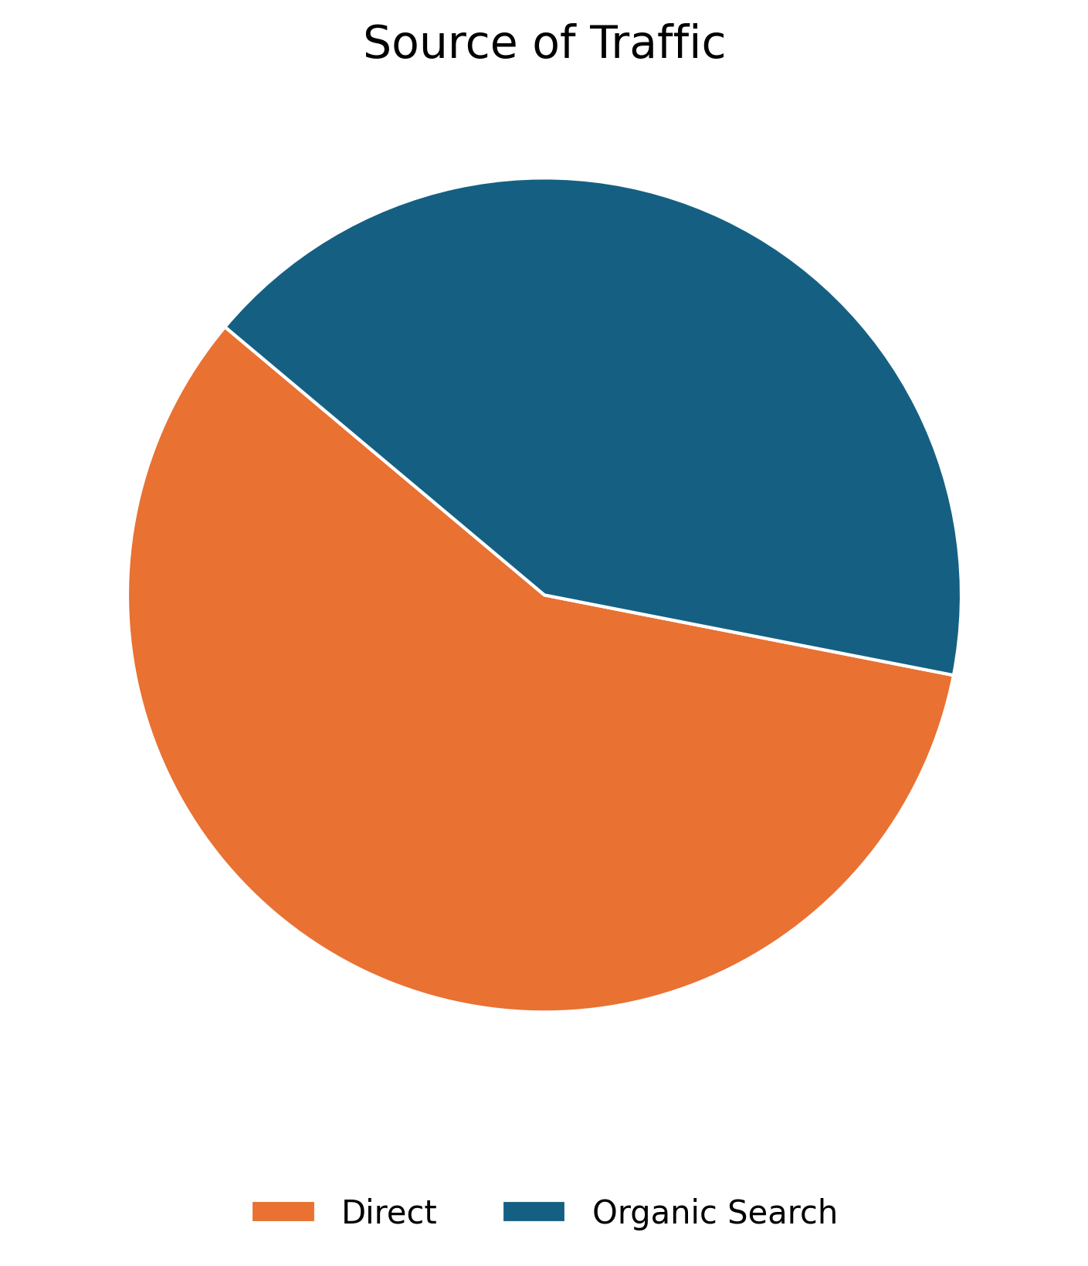
01 July 2025
User Acquisition
The data on this slide illustrates the various traffic channels bringing users to the Zimplats website. The pie chart reveals that the majority of traffic comes from Direct Search.
Source | Users43
Organic Search | 81
Direct | 112

Slide 8
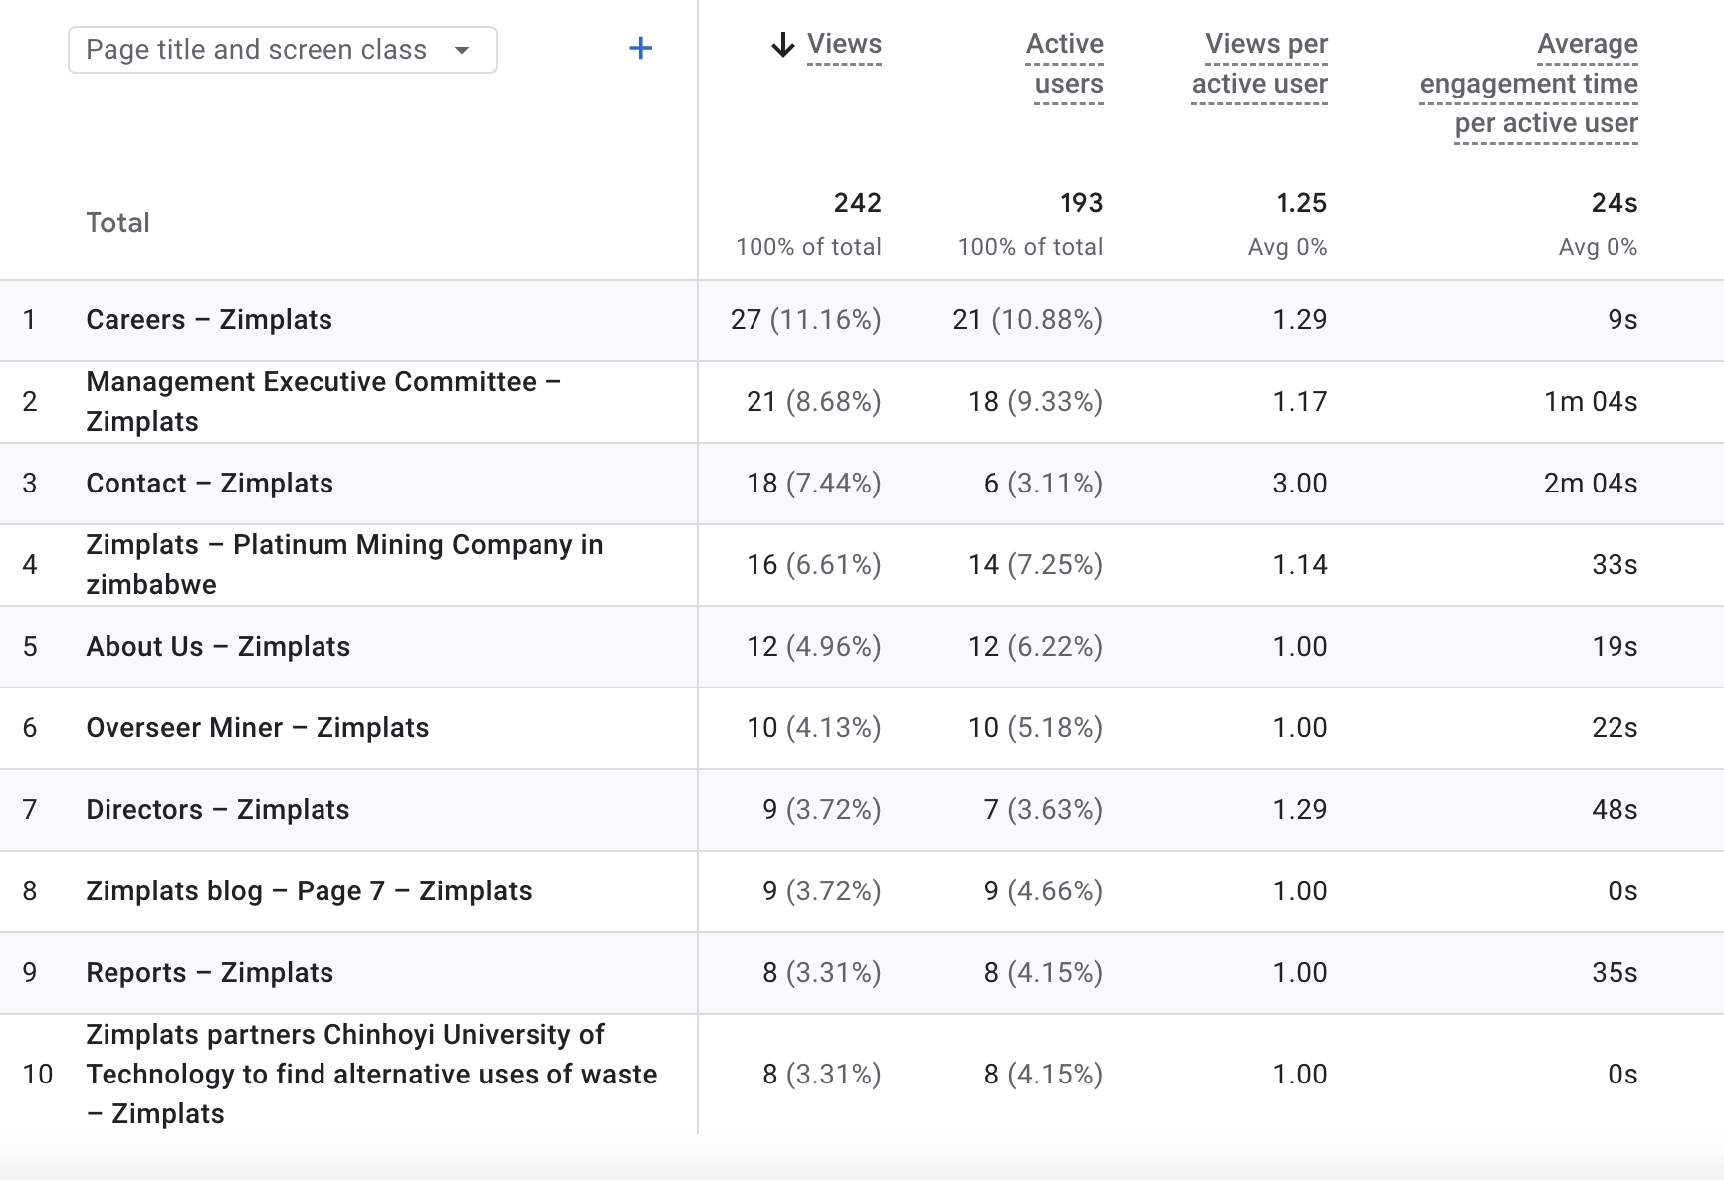

02 March 2026
Pages Sessions
The table shows the top pages visited by users in the previous month

Slide 9
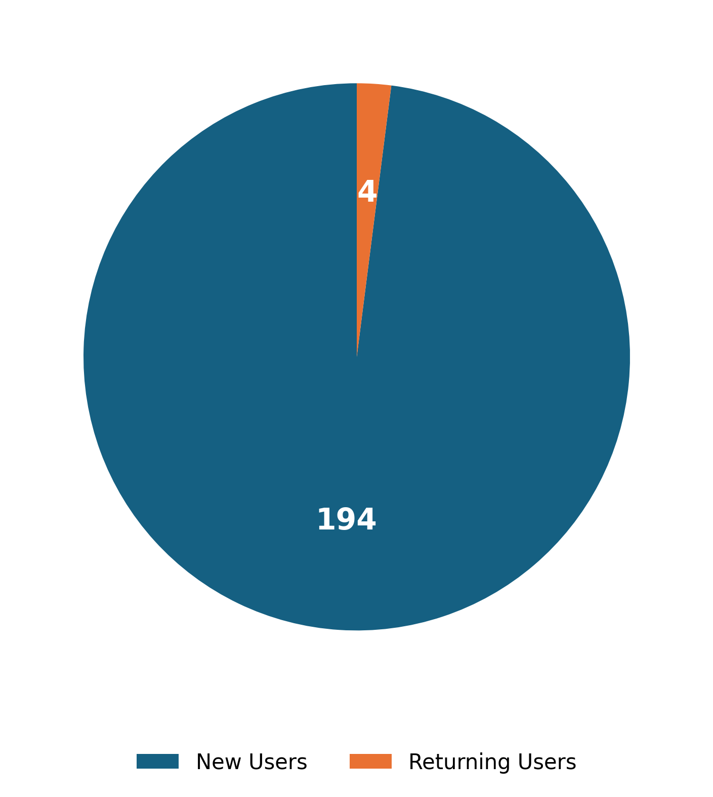
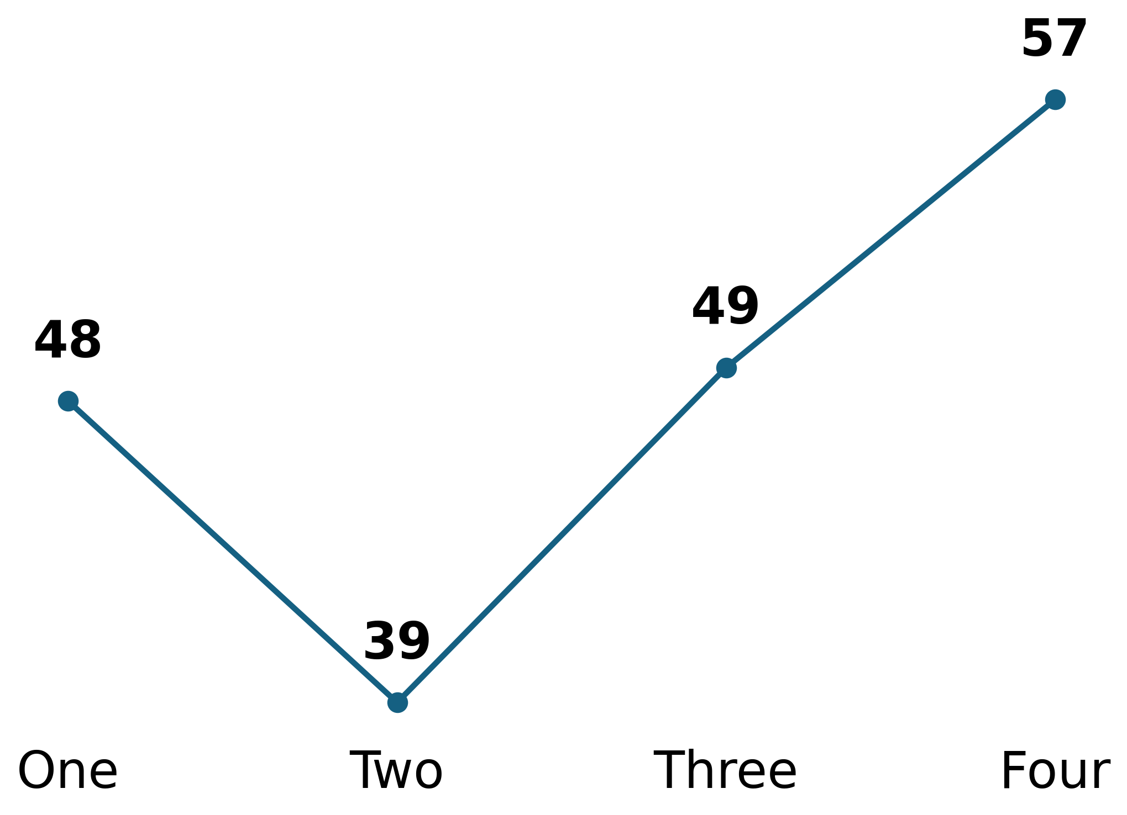
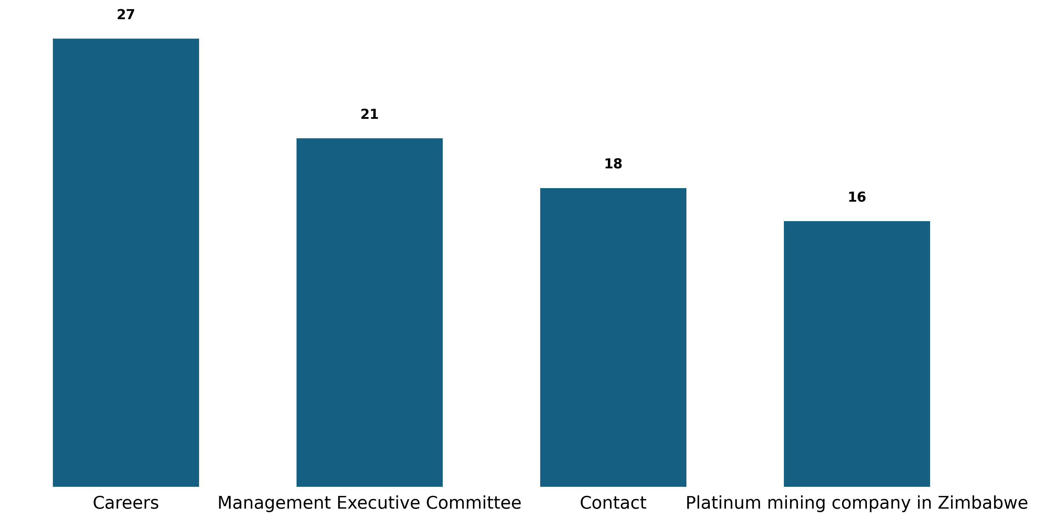
02 March 2026
Behavior Analysis
Users
Engagement Rate Per Week
Page Views
Based on user interactions.
Measure user interaction.
Track page visits.

Slide 10

02 March 2026
Recommendations
Based on data insights
1. Increase Active Users: Launch a "Mining 101" educational series focused on the Zimbabwean Great Dyke to capture new search traffic and encourage users to explore more than one page per session.
2. Increase Returning Users: Build out the "Impact Hub" with frequent updates on initiatives like the Kadoma project, giving visitors a reason to check back for progress despite any current real-world challenges.
3. Enhance User Engagement: Add a "Quick Summary" box at the top of the page where the PDFs are hosted to give users the "too long; didn't read" version before they download.

